Slide 1
Messaging System
Apache Kafka
@bbaral

Slide 2
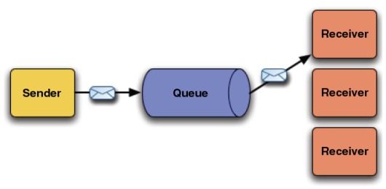
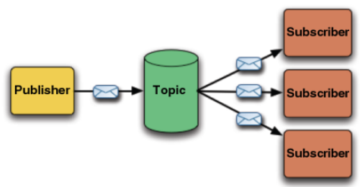
Messaging system
Point to point
Publish-subscribe

Slide 3
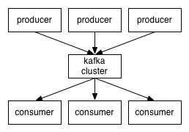
Apache Kafka
Kafka is a distributed, partitioned, replicated commit log service.
Kafka maintains feeds of messages in categories called topics.
processes that publish messages to a Kafka topic producers.
processes that subscribe to topics and process the feed of published messages consumers.
Kafka is run as a cluster comprised of one or more servers each of which is called a broker.

Slide 4
Real time transfer
Zookeeper
Update Consumed
Message offset
Consumer1
(Group1)
get Kafka broker address
Queue
Topology
Consumer2
(Group1)
Producer
Kafka Broker
Consumer3
(Group2)
Kafka Broker
Streaming
Topic
Topology
Fetch messages
Consumer4
(Group2)

Slide 5
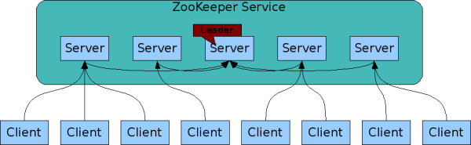
The ZooKeeper Service
ZooKeeper Service is replicated over a set of machines
All machines store a copy of the data (in memory)‏
A leader is elected on service startup
Clients only connect to a single ZooKeeper server & maintains a TCP connection.
Client can read from any Zookeeper server, writes go through the leader & needs majority consensus.

Slide 6
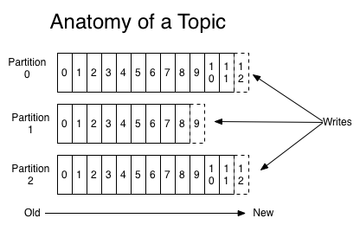
Topics and Logs
Topic , to which messages are published. For each topic, the Kafka cluster maintains a partitioned log that looks like this.

Slide 7
Steps For kafka :
Start Server
Start zookeeper server
> bin/zookeeper-server-start.sh config/zookeeper.properties
2. Start kafka server.
> bin/kafka-server-start.sh config/server.properties
For example, in server.properties used for broker1, we define the following:
broker.id=1
port=9092
log.dir=/tmp/kafka-logs-1
Create Topic
> bin/kafka-topics.sh --create --zookeeper localhost:2181 --replication-factor 1 --partitions 1 --topic test
Verify the list of topics --
> bin/kafka-topics.sh --list --zookeeper localhost:2181
Producer
> bin/kafka-console-producer.sh --broker-list localhost:9092 --topic test
Consumer
> bin/kafka-console-consumer.sh --zookeeper localhost:2181 --topic test --from-beginning

Slide 8
JAVA API KAFKA Producer
Simple Producer
Properties props = new Properties();
props.put("metadata.broker.list","localhost:9092"); props.put("serializer.class","kafka.serializer.StringEncoder");
props.put("request.required.acks", "1");
ProducerConfig config = new ProducerConfig(props);
Producer<String, String> producer = new Producer<String, String> (config);
KeyedMessage<String, String> data = new KeyedMessage<String, String>(topic, msg); the producer.send(data);
Producer.close();
producer with custom partitioning
props.put("partitioner.class", "kafka.xxx.SimplePartitioner");
public class SimplePartitioner implements Partitioner {
…….
}

Slide 9
JAVA API KAFKA Consumer
Consumer
Properties props = new Properties();
props.put("zookeeper.connect", "localhost:2181");
props.put("group.id", "testgroup");
props.put("zookeeper.session.timeout.ms", "500");
props.put("zookeeper.sync.time.ms", "250");
props.put("auto.commit.interval.ms", "1000");
ConsumerConnector consumer= new ConsumerConfig(props);
Map<String, Integer> topicMap = new HashMap<String, Integer>();
topicMap.put(topic, new Integer(1));
Map<String, List<Kafka Stream<byte[], byte[]>>> consumerStreamsMap = consumer.createMessageStreams(topicMap);
List<Kafka Stream<byte[], byte[]>> streamList = consumerStreamsMap.get(topic);

Slide 10
Thank You
http://kafka.apache.org/
https://github.com/biswajitbaral/kafka

